Slide 1
Web Services
Dongpo Wu
Jan 5, 2008

Slide 2
Agenda
Webservice Overview
Mule Overview
Exposing a Web Service using Mule
More information

Slide 3
Web services
A collection of XML-based technologies developed by the e-business community to address issues of:
  service discovery
  interoperable data exchange and/or application invocation
  service compositions (workflow, business processes)
Major developers include:
  Apache, IBM, HP, SUN & Microsoft (.NET)
http://www.webservices.org/
Notes:
The promise of web services is to enable a distributed environment in which any number of applications, or application components, can interoperate seamlessly among and between organizations in a platform-neutral, language-neutral fashion. This interoperation brings heterogeneity to the world of distributed computing once and for all.

Slide 4
W3C (working group) definition
"A Web service is a software application identified by a URI, whose interfaces and bindings are capable of being defined, described and discovered as XML artefacts. A Web service supports direct interactions with other software agents using XML based messages exchanged via internet-based protocols."
http://www.w3c.org/TR/2002/WD-wsa-reqs-20020819

Slide 5
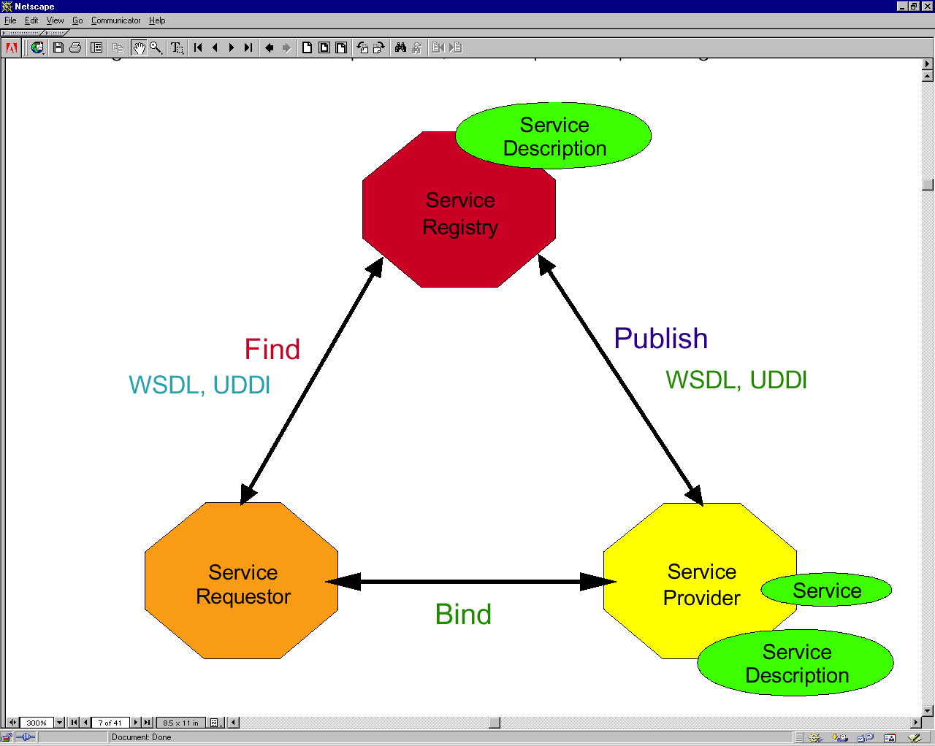
Web Services Architecture

Slide 6
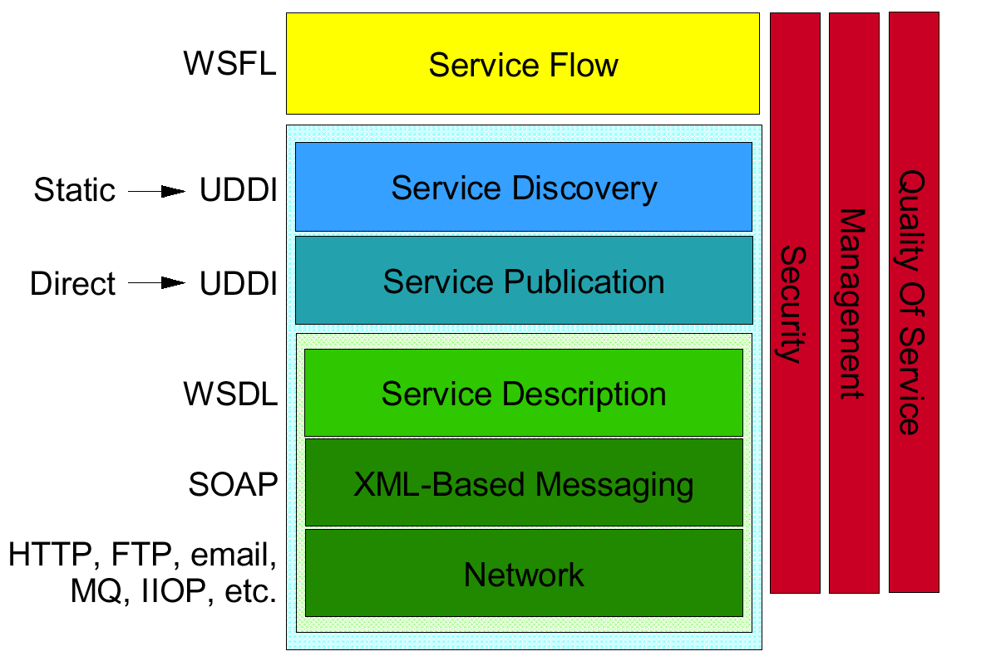
Web Services Stack

Slide 7
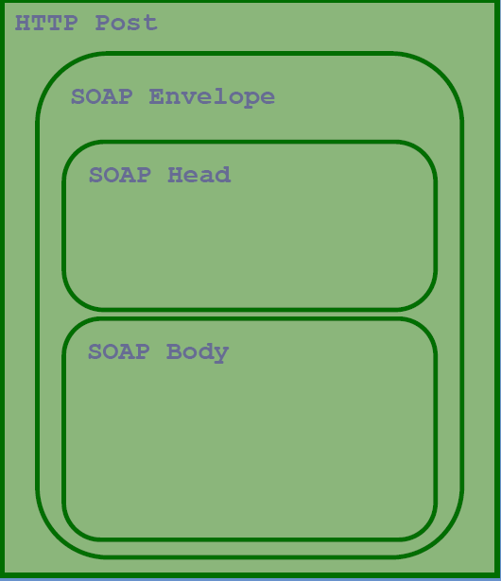
SOAP Envelope
<SOAP-ENV:Envelope
xmlns="http://schemas.xmlsoap.org/soap/envelope/">
< SOAP-ENV:Header>
...
</ SOAP-ENV:Header>
< SOAP-ENV:Body>
...
</ SOAP-ENV:Body>
...
</ SOAP-ENV: Envelope>

Slide 8
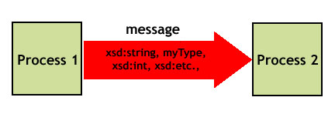
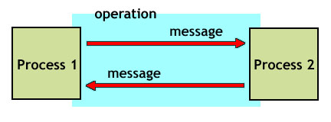
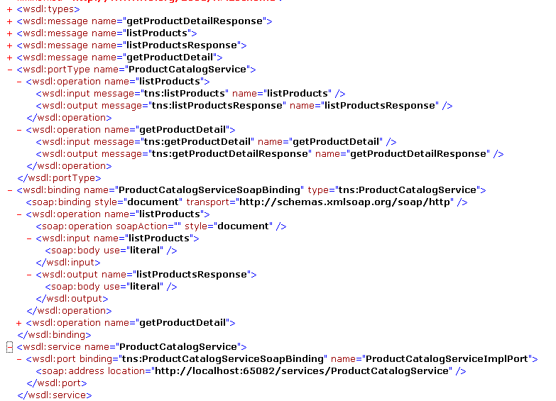
WSDL - Web Services Description Language
Web Services Definition Language
  http://www.w3.org/TR/wsdl/
An XML-based language for describing Web Services
  what the service does (description)
  how to use it (method signatures)
  where to find the service
It does not depend on the underlying protocol
But: It is not much human-readable
Notes:
IDL: Interface description language
<types> WSDL 元素允许您指定数据类型，无论这些类型多简单或多复杂，这些类型是 WSDL 文件所描述的 Web 服务接口必需的。types 类似于 Java 类和基本类型。
<message> 元素将数据（数据类型在 <types> 元素中进行定义）分组成一个用于逻辑网络传输的特征符，并将数据绑定到一个名称上。
<portType> 元素在 WSDL 中相当于 Java 中的接口。它将对 <message> 元素的引用分组成逻辑操作，一个进程可以对另一个进程执行这些操作，并将它们绑定到一个名称。<operation> 可以包含 <input>、<output> 和 <fault> 元素。对于所有这三个元素，message 属性引用 WSDL 文件中所定义的 <message> 元素。<input> 元素声明客户机向 Web 服务请求传输的需求。<output> 声明 Web 服务响应的内容。<fault> 元素描述当 Web 服务设法响应客户机的请求时所发生的任何消息级异常
<Binding>就某个具体的传输或消息传递协议而言（即 SOAP、SMTP 和 HTTP 等等），到目前为止所列出的 WSDL 元素都是抽象的。使用任何协议的组织都可以实现上面所述的 Web 服务接口。WSDL <binding> 元素的内容将这些抽象的钩接点与 Web 协议束缚起来。binding 元素既有 name 属性（用来在 WSDL 文档内标识该绑定），又有 type 属性（用来引用该元素描述绑定时所针对的 portType）。它还有 <operation> 元素，与它所绑定的 <portType> 中的每个 <operation> 元素对应。在 <operation> 元素又有 <input>/<output>/<fault> 元素，与相应的 <operation> 元素中所定义的元素相对应。描述绑定的元素嵌套在 <binding> 元素的这些子元素之中，这是为了将消息传递协议的详细内容链接到目标 portType 中所提到的通则上。
<service> WSDL 元素将某个具体的绑定与网络上的一个或多个进程相关联，这些进程可以根据绑定所实现的 portType 来处理请求。对于 HTTP 上的 SOAP，这就是指向那个进程的 URL

Slide 9
WSDL Structure
portType
  Abstract definition of a service (set of operations)
Multiple bindings per portType:
  How to access it
  SOAP, JMS, direct call
Ports
  Where to access it
Service
Port
(e.g. http://host/svc)
Port
Binding
(e.g. SOAP)
Binding
Abstract interface
portType
operation(s)
inMesage
outMessage

Slide 10
Using WSDL
As extended IDL: WSDL allows tools to generate compatible client and server stubs.
    Tool support for top-down, bottom-up and “meet in the middle” development.
Allows industries to define standardized service interfaces.
Allows advertisement of service descriptions, enables dynamic discovery and binding of compatible services.
    Used in conjunction with UDDI registry
Provides a normalized description of heterogeneous applications.

Slide 11
UDDI
Universal Description, Discovery and Integration
  http://uddi.xml.org/
UDDI creates a platform-independent, open framework & registry for:
  Describing services
  Discovering businesses
  Integrating business services

Slide 12
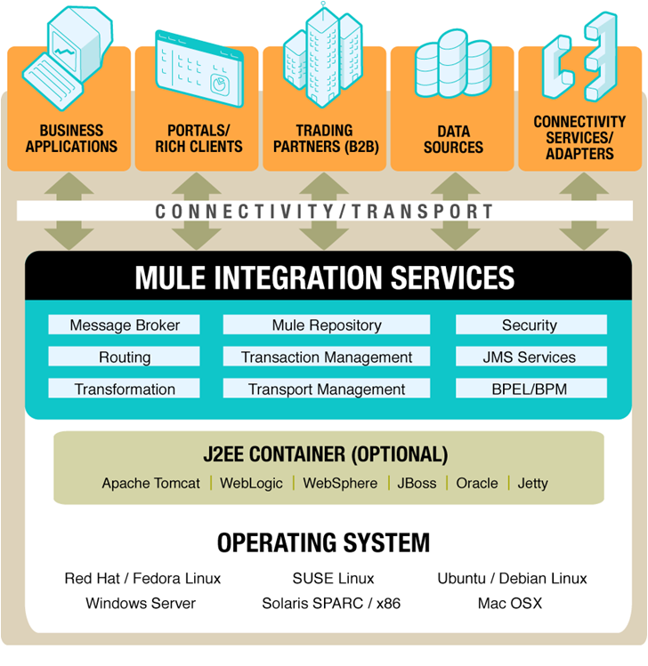
Mule Overview

Slide 13
Introduce to Mule(1/2)
Service container and messaging platform
Supports a variety of service topologies including ESB
Highly Scalable; using SEDA event model
End-to-End Data Transformation
End-to-End Data Transformation
Powerful event routing capabilities (based on EIP book)
Transparent Distribution
Transactions; Local and Distributed (XA)
Fault tolerance; Exception management
Secure; Authentication/Authorization
Notes:
SEDA: Staged Event-Driven Architecture
SEDA decomposes a complex, event-driven application into a set of stages connected by queues. This design avoids the high overhead associated with thread-based concurrency models, and decouples event and thread scheduling from application logic.

Slide 14
Introduce to Mule(1/2)
Support for over 25 messaging protocols/transports
– JMS, JDBC, TCP, UDP, Multicast, HTTP, Servlet, WS
– SMTP, POP3, File, XMPP, FTP, EJB, VFS, SSL and more...
JBI and BPEL support
App Servers – Weblogic, Websphere, JBoss,
Mainframe Support (AS400)
Scheduling
Scripting (JSR-233)
Management and Monitoring using JMX
Mule IDE, configuration mapping
Notes:
JBI: Java Business Integration
BPEL: the Business Process Execution Language
Mainframe support(AS400): Mule can now communication with IBM AS400 data queues in the same way as all other transports making mainframe integration much eaiser.
JSR-233:Mobile Device Management and Monitoring

Slide 15
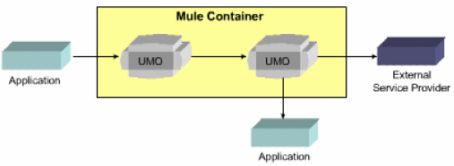
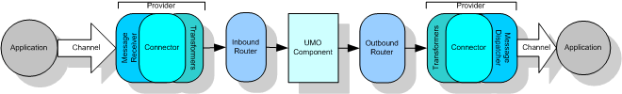
Mule Architecture

Slide 16
Mule Flow View
Channel – a method of connecting between two points (not part of Mule)
Connector – a transport provider (e.g., http, jms, soap, smtp, etc) implementing message receive and message dispatch
Transformer – converts message structure/format (e.g., http to xml)
Router – moves messages amongst UMOs and connectors

Slide 17
UMO Service
UMO Services in Mule can be any object -
POJOs, EJBs, Remote Objects, WS/REST Services
A service will perform a business function and may rely on other sources to obtain additional information
Configured in Xml, or programmatically
Mule Manages Threading, Pooling and resource management
Managed via JMX at runtime
Notes:
UMO is a Universal Message Object

Slide 18
Endpoints
Used to connect components and external systems together
Endpoints use a URI for Addressing
Can have transformer, transaction, filter, security and meta-information associated
Two types of URI
  scheme://[username][:password]@[host][:port]?[params]
    smtp://someone@localhost:25
  scheme://[address]?[params]
    jms://my.queue?persistent=true

Slide 19
Routers
Control how events are sent and received
Can model all routing patterns defined in the EIP Book
Inbound Routers
  Idempotency
  Selective Consumers
  Re-sequencing
  Message aggregation
Outbound Routers
  Message splitting / Chunking
  Content-based Routing
  Broadcasting
  Rules-based routing
  Load Balancing

Slide 20
Transformers
Converts data from one format to another
Can be chained together to form transformation pipelines

Slide 21
Exposing a Web Service using Mule

Slide 22
Web Service Example
For this example, we are going to be creating a Product Catalog service, where users can get a list of the products that we sell, and can also get the details for specific products

Slide 23
What’s CXF
Successor to XFire
Apache web services framework
JAX-WS compliant
SOAP, WSDL, WS-I Basic Profile
WS-Addressing, WS-Security, WS-Policy, WS-ReliableMessaging

Slide 24
Demo

Slide 25
Testing the service
http://localhost:65082/services/ProductCatalogService?wsdl
http://localhost:65082/services/ProductCatalogService/listProducts
http://localhost:65082/services/ProductCatalogService/getProductDetail/productId/SW123
Testing the service with SoapUI

Slide 26
More information
SOAP
http://www.w3c.org/TR/soap
WSDL
  http://www.w3c.org/TR/wsdl
UDDI
  http://www.uddi.org
Mule
  http://mule.mulesource.org
MuleForge
  http://muleforge.org

